Slide 1
Team
B!g_Data_Army
Table #2
Problem Statement #2
Internet of Things
Notes:
These are stats per year, only for City of Toronto
Break-ins cost Canadian insurance companies millions of dollars each year in claim payments as well as policyholders through increased premiums.

Slide 2
8424
Number of Reported Burglaries *
322
Reported Burglaries per 100,000 Residents*
15
% Increase from 2018 to 2019**
* Toronto Police Services stats
** Statistics Canada
Notes:
These are stats per year, only for City of Toronto
Break-ins cost Canadian insurance companies millions of dollars each year in claim payments as well as policyholders through increased premiums.

Slide 3
Existing alarm systems are more reactive than proactive
Notes:
What is the problem?

Slide 4
Crowd Security
AI Powered Behaviour Detection, Prediction and Prevention System
Shared Computing Platform Leveraging the Synergy of Communication Network
Notes:
A social-conscious network, directly engaging the participants to take active roles in the safety and security of their neighborhoods.

Slide 5
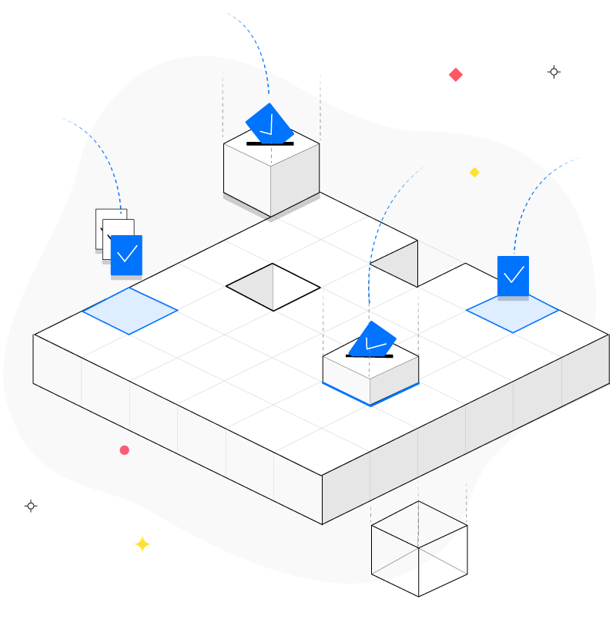


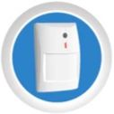


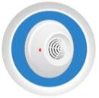

Solution Architecture
Decentralized shared AI back-end platform
Central computing unit
Rogers
Touchpad
Centralized cloud
Leveraging existing Rogers Smart Home Monitoring hardware

Slide 6
AI models
Preventive Actions
Voice Matching
Face Matching
Same face on Backyard
Same face on Neighborhood
Mask Detection
Weapon Detection
Door-knob Attempt
Car-handle Attempt
Motion Detection
Electronic Signatures
Broken Glass Sound Pattern
Broken Door Sound Pattern
Gunshot Sound Pattern
Profile builder
Low risk profile
Flyer delivery
Postman
Lawn care
Radio On/Off
TV On/Off
Outdoor lights
Indoor Lights
Alarm Siren
Strobe Lights
Escalation to Security Company
Recognize Patterns
Notes:
List of models
That will identify paterrns , which will trigger action steps

Slide 7

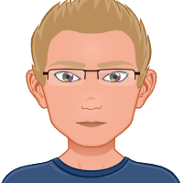
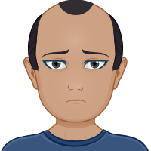
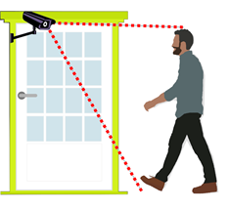
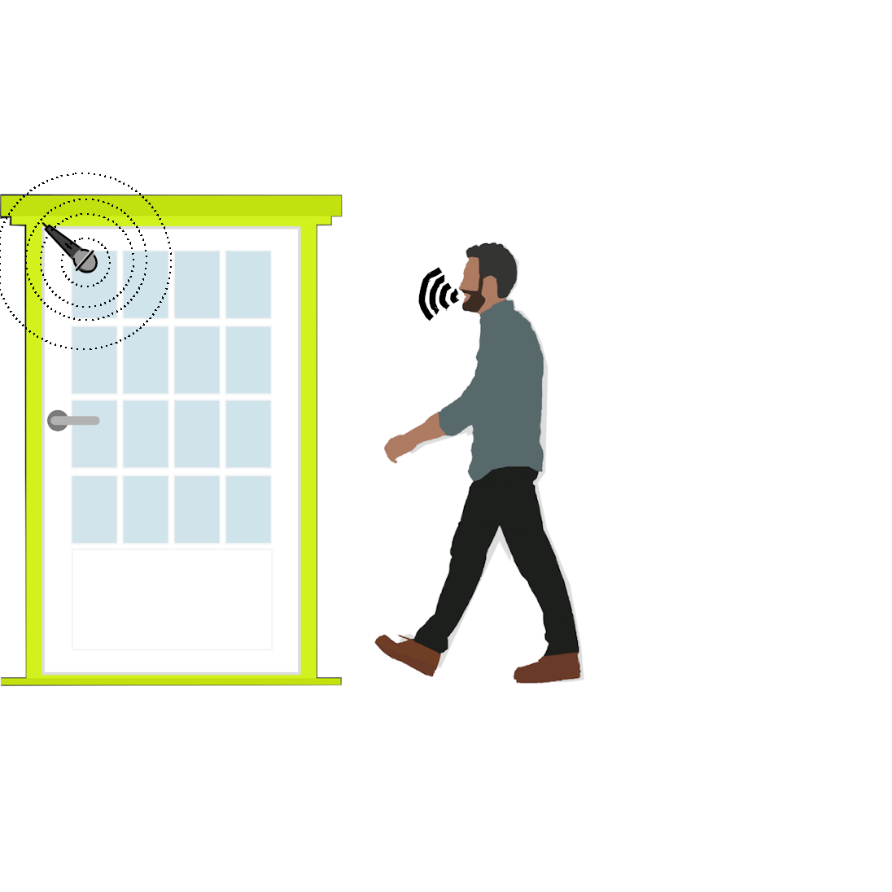
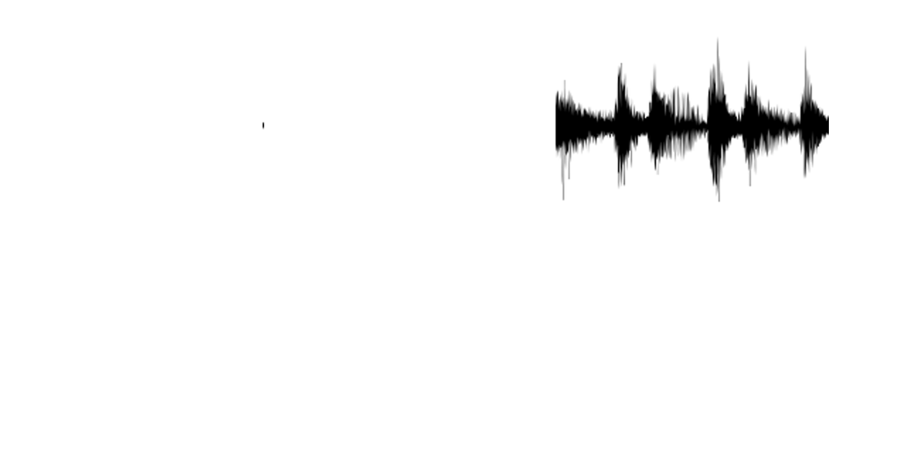
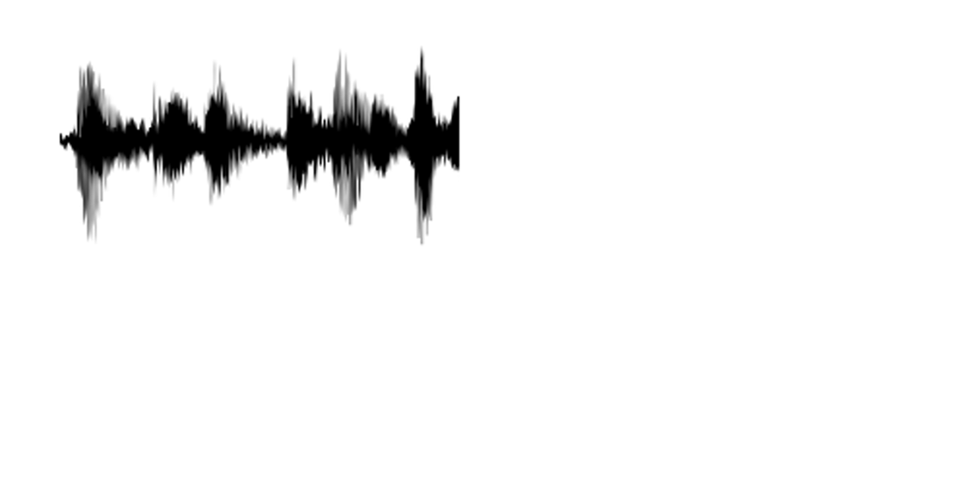
==
AI-powered image processing compares the face of the front-door person with the ones of the residents stored in the system. Decide if YES or NO
==
AI-powered sound processing compares the voice of the front-door person with the ones of the residents stored in the system. Decide if YES or NO
Notes:
Face matching
Voice matching

Slide 8




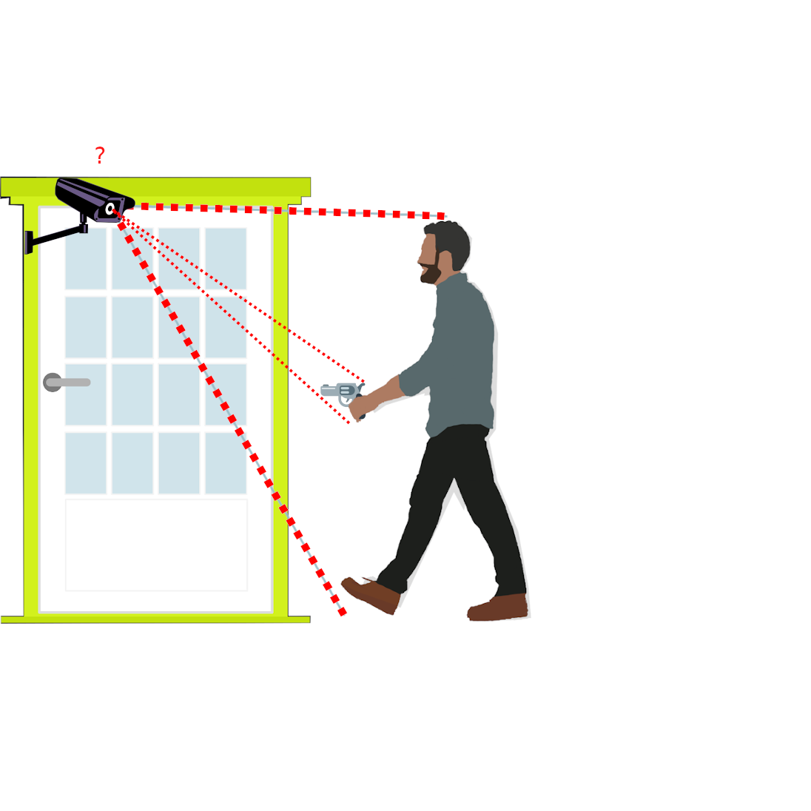
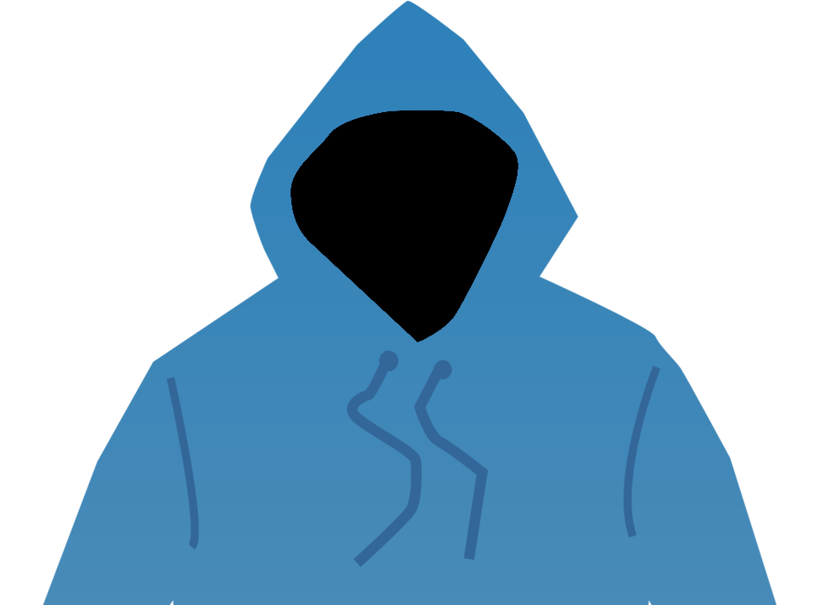

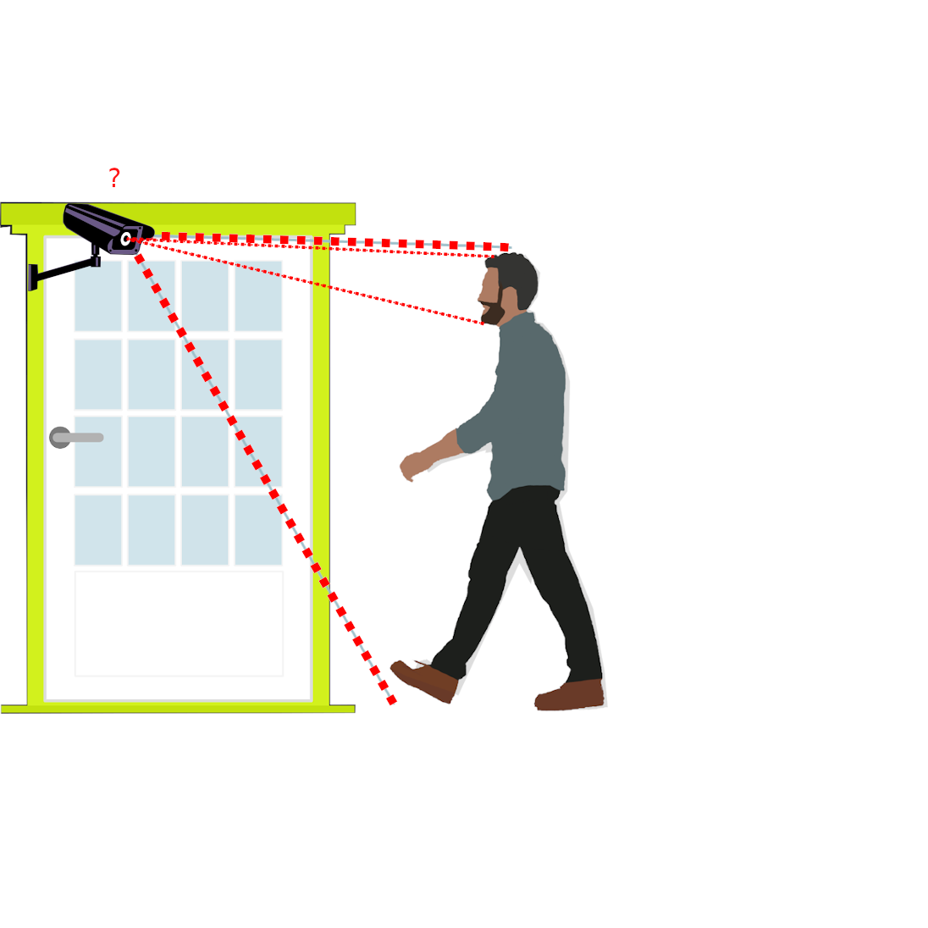
?
?
?
AI-powered image processing detects if the front-door person has weapons or robbery tools. Decide if YES or NO
?
?
AI-powered image processing detects of the person in front of the door has his face covered with a mask. Decide if YES or NO
Notes:
Object detection– like weapon, robbery tools
Covered face – like ski mask

Slide 9
Examples of Event Correlation
Person presence detected
Face matching
Voice matching
Doorbell/ knock-on the door
Door-knob attempt
Event Correlation Algorithm decides on the next preventive actions
TV Sound on
Lights on
Alarm Siren
Notifying Central Monitoring Station
Different combinations of events in multiple households will adjust the risk profile accordingly
Inter-neighbourhood event correlation captures events occurring in multiple households
Notes:
This is example of event corellation

Slide 10
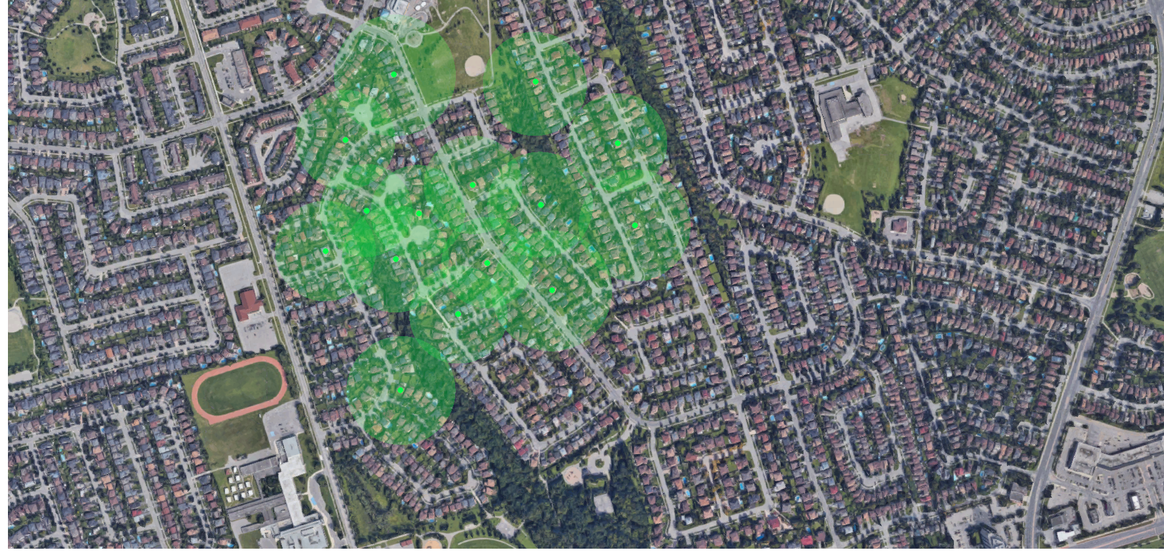
Neighbourhood Security Network
Security events are being transmitted via Neighbourhood Security Network
The network runs on limited number of neighborhood nodes – vicinity cloud
Notes:
What is the problem?

Slide 11
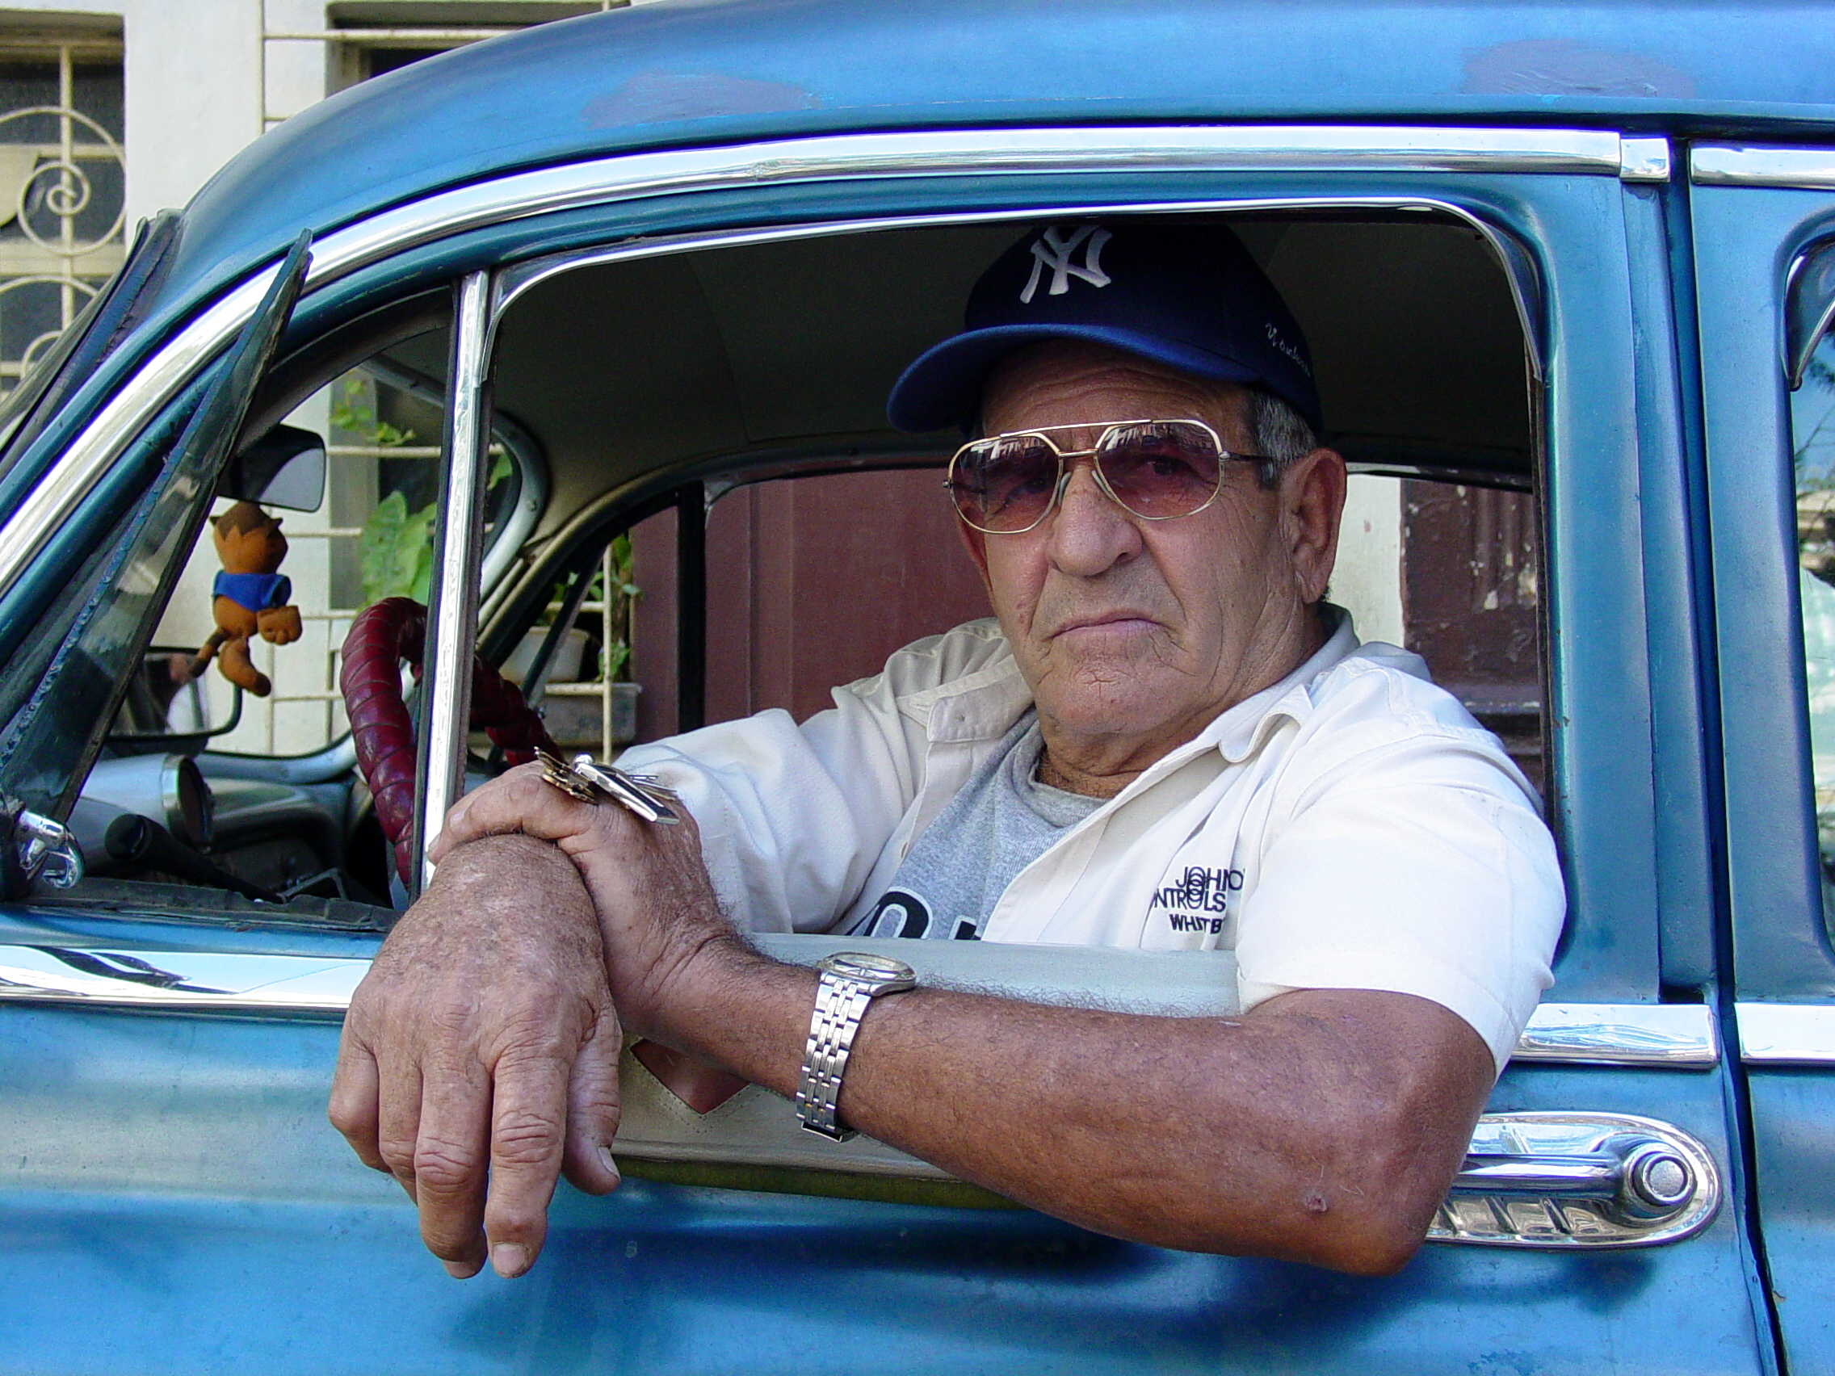
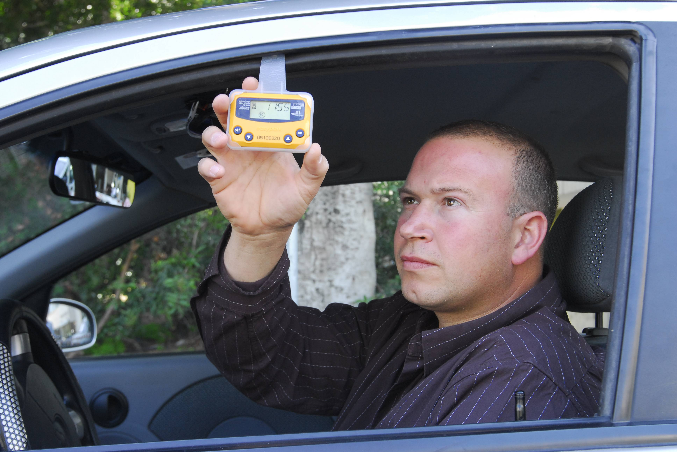
Crowd Security Participant
People responding to security threat events.
Actual people, registered on the platform, and willing to respond
Platform app on their cells notifies them of the events
The algorithm notifies a number of responders, based on proximity
Duties: drive to location, turn on the high beam lights, honk the horn, observe the surroundings, assess the situation
If anything suspicious, take pictures, or video record
On serious assessment, call emergency or police
Presence gets confirmed by the requesting node, based on the electronic signature of their cell phone and their running app.
Notes:
What is the problem?

Slide 12
Business Value
Our platform would be ideal use case for upcoming 5G network in Canada
Increase customer satisfaction
Increase revenue from Services – monthly-monitoring and some new service offerings
Increase revenue from Hardware sale
Reduction of False Alarms and disputes/complains related to False Alarms (Verified Alarm Response regulations being adopted by Police services in North America)
Reduce headcount at Roger's Central monitoring station
Monetization of data collected – sell to insurance providers and/or used for marketing revenue, research
Increase reputation of Roger's Home Security System (currently 2 stars)
Opportunity to grow business beyond residential only, commercial or public spaces, buildings
Faster response to incidents
Social Benefits
Customers well-being (Based on Criminal Victimization Study)*
6% have sleeping problems and/or depression
8% have long term PTSD
Savings for insurance companies and for customers through lower premiums as well as deductibles amount paid via insurance claim
* Statistics Canada

Slide 13
Crowd Security
We put the Smart into Smart Home Monitoring
Notes:
What is the problem?

Slide 14
Q & A
Notes:
What is the problem?

Slide 15
Supporting Materials
Notes:
What is the problem?

Slide 16
Appendix:
What a Burglar Looks For
Most thieves target homes that look easy to break into. They often pick a house by surveilling the neighborhood and finding the one with the most predictable patterns of when people come and go. They also look for properties in more rural or isolated parts of the neighborhood, and houses that are well maintained or have fancy cars in the driveway.
Most burglars enter houses through those entry points as well as the front door, the back door, or the garage.
When a Burglar Is Most Likely to Strike
Burglars want their jobs to be as easy as possible, so if they know you leave for work at 8 a.m. every day and don’t return until 6 p.m., they’re most likely to strike when you’re gone. Summer is the high season for break-ins because many people take summer vacations while their kids are out of school. Many people go on vacations over the major holidays, too, making their homes prime targets for theft.

Slide 17
Appendix:
Top 10 deterrents for burglars
CCTV camera
Sound of a barking dog
Strong, heavy doors
TV that has been switched on
Locked UPVC windows
Cars parked on driveway
Overlooking property
Surrounding fences
Gates outside the property
Motion-activated security lights

Slide 18
Appendix:
Electronic Signatures Monitoring
Nearly all electronic devices, that have wireless connectivity, are broadcasting a continuous and traceable electromagnetic trail – called beacon
These include: Wi-Fi, Bluetooth, 433MHz, 868MHz and GSM/LTE frequencies
Examples:
Cars – Bluetooth
Headsets – Bluetooth, 433Mhz
Cell phones – GSM, Wi-Fi, Bluetooth
Garage Openers
These signatures can be captured and recorded as security events

Slide 19
Code snippets for voice matching
// voice pattern recognition
import numpy as np
import pandas as pd
import seaborn as sns
sns.set_style('whitegrid')
import matplotlib.pyplot as plt
from keras.models import Model
from keras.layers import Dense, Dropout, Bidirectional, CuDNNGRU, Reshape, GlobalMaxPooling1D, GlobalAveragePooling1D, Input, concatenate, BatchNormalization
from keras.optimizers import Adam
from keras.callbacks import ReduceLROnPlateau
from sklearn.metrics import accuracy_score
// Using TensorFlow backend.

Slide 20
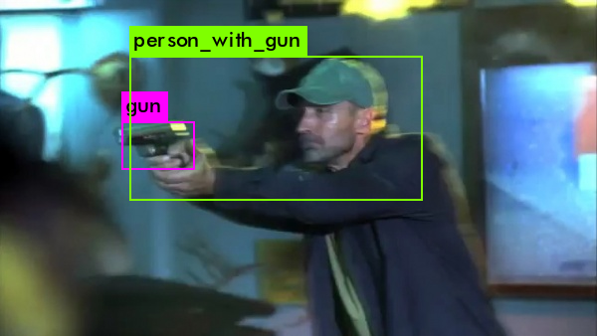
Code snippets for Object Recognition (Weapons)
Object detection model using YOLO Darknet to detect harmful weapons such as gun and knife, in the hands of a person.
def detect(net, meta, image, thresh=.5, hier_thresh=.5, nms=.45):
im = load_image(image, 0, 0)
boxes = make_boxes(net)
probs = make_probs(net)
num = num_boxes(net)
network_detect(net, im, thresh, hier_thresh, nms, boxes, probs)
res = []
for j in range(num):
for i in range(meta.classes):
if probs[j][i] > 0: res.append((meta.names[i], probs[j][i], (boxes[j].x, boxes[j].y, boxes[j].w, boxes[j].h)))
res = sorted(res, key=lambda x: -x[1]) free_image(im)
free_ptrs(cast(probs, POINTER(c_void_p)), num)
return res

Slide 21
Code snippets for Electro-Magnetic Device Signature Monitoring (Wifi)
https://github.com/kissste/esp8266-Arduino-WifiSniffer/blob/master/ESP8266-Arduino-WifiSniffer.ino
void setup () {
Serial.begin(115200); delayMicroseconds(100);
Serial.println("*** Monitor mode test ***"); Serial.print(" -> Promisc mode setup ... ");
wifi_set_promiscuous_rx_cb(promisc_cb);
wifi_promiscuous_enable(1);
Serial.println("done.");
Serial.print(" -> Timer setup ... ");
os_timer_disarm(&channelHop_timer);
os_timer_setfn(&channelHop_timer, (os_timer_func_t *) channelHop, NULL); os_timer_arm(&channelHop_timer, CHANNEL_HOP_INTERVAL, 1);
Serial.println("done.\n");
Serial.print(" -> Set opmode ... ");
wifi_set_opmode( 0x1 );
Serial.println("done.");
Serial.println(" -> Init finished!");
}
void loop() { delay(10); }

Slide 22
Code snippets for Electro-Magnetic Device Signature Monitoring (Bluetooth - BLE)
https://github.com/moononournation/Arduino_BLE_Scanner/blob/master/Arduino_BLE_Scanner.ino
BLEDevice::init(""); // put your main code here, to run repeatedly: BLEScan *pBLEScan = BLEDevice::getScan(); //create new scan pBLEScan->setAdvertisedDeviceCallbacks(new MyAdvertisedDeviceCallbacks()); pBLEScan->setActiveScan(true); //active scan uses more power, but get results faster pBLEScan->setInterval(0x50); pBLEScan->setWindow(0x30); #ifdef SERIAL_PRINT Serial.printf("Start BLE scan for %d seconds...\n", SCAN_TIME); #endif BLEScanResults foundDevices = pBLEScan->start(SCAN_TIME);
for (int i = 0; i < count; i++) {
BLEAdvertisedDevice d = foundDevices.getDevice(i);
if (d.haveManufacturerData()) { std::string md = d.getManufacturerData(); uint8_t* mdp = (uint8_t*)d.getManufacturerData().data(); char *pHex = BLEUtils::buildHexData(nullptr, mdp, md.length()); ss << ",\"ManufacturerData\":\"" << pHex << "\""; free(pHex); }
}

Slide 23
AI based Security Threat Risk Assessment
Events from vicinity nodes are fed to Machine Learning (ML) algorithm which predicts risk of threat
As a result of the risk assessment, deterrents might be activated.
Deterrents can be local or attached to the vicinity nodes (For example – neighbor's house front door lights would turn on)
Risk threat level and the distance to the source of events will influence nodes participation (deterrent as well as notification of participants and residents).
Notes:
This is example of event corellation

Slide 24
Back-end Platform Concepts
The back-end platform is a Distributed Ledger Technology (DLT) which is a blockchain, running on limited number of neighborhood nodes – vicinity clouds
A blockchain of security events
Vicinity clouds – no actual borders, they overlap, mix and continuously cross over each other

Slide 25
Back-end Platform Concepts - cont
The blockchain records security events, each one only within its own vicinity cloud
Basic consensus, based on replication of the security events
To get accepted on the blockchain, each node needs proof-of-stake, a minimum amount of the platform’s crypto-coin in its wallet.
The master nodes perform proof-of-computing to maintain the DL, by performing AI image processing for the validation nodes
Validator nodes confirm the proof-of-computing, as events on the blockchain.
The master nodes are rewarded with the crypto-coin of the platform, for performing the proof-of-computing
Each unit of computing done by a master node for a validation node gets paid from the wallet of the validation node
Owners of any participating node can sign for the crowd security sourcing, and respond to a serious security event, or security threat.
Each security action response of a crowd security participant, as a result of a security threat, gets rewarded with the crypto-coin of the platform, from the wallet of the node requiring the attention or intervention.
The is NO crypto-coin mining; all the coins consumed by the proof-of-computing or security action responses, are sourced from the wallets of the validation nodes, or from the wallets of nodes requiring intervention.

Slide 26
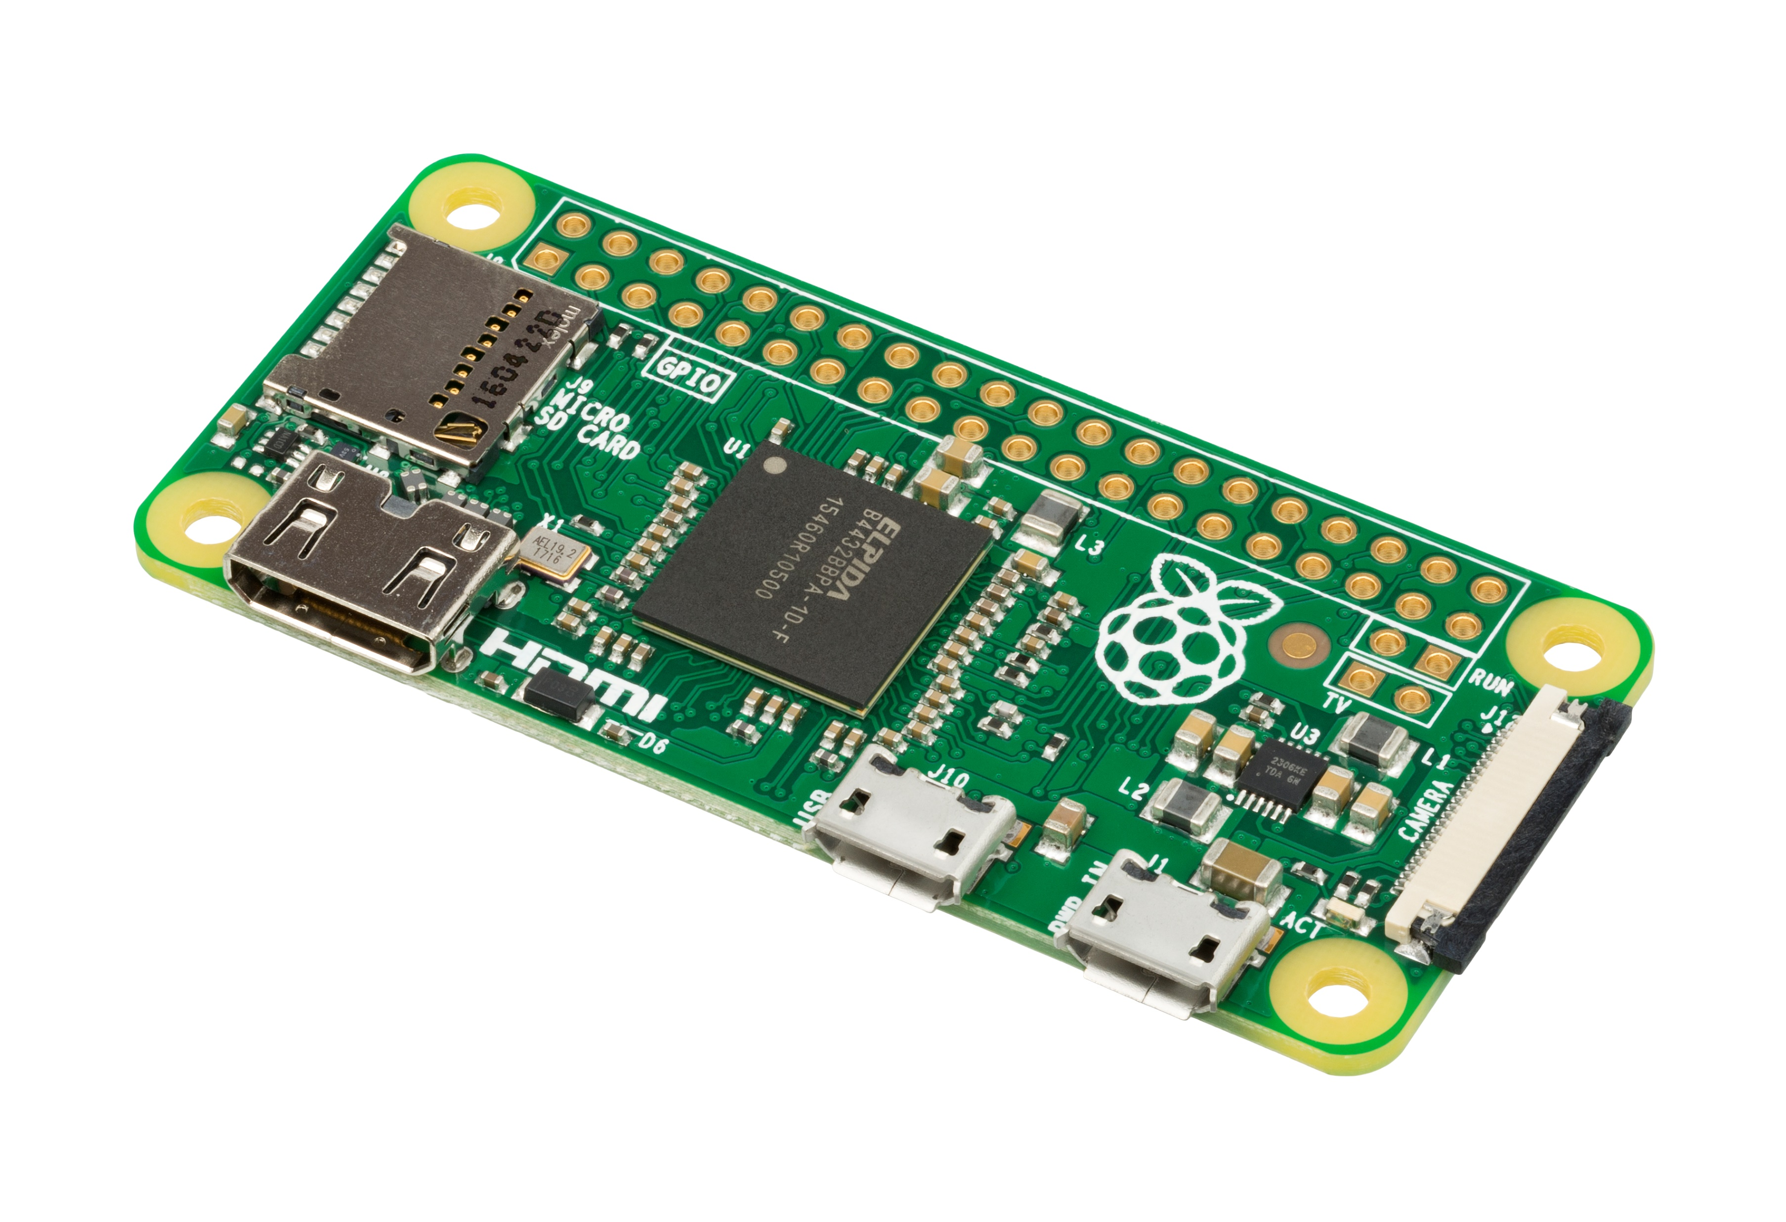
Unit Hardware Architecture
Decentralized shared back-end platform
Central computing unit
SSD storage
Capture WiFi, BlueTooth, GSM, etc, signatures
GPU
CPU
IO cards
Network, WiFi
Centralized cloud
Existing Rogers smart home monitoring hardware

Slide 27

Unit Software Architecture
AI models
User Interface
setup
configuration
Blockchain wallet
Voice Matching
Electronic Signatures
Face Matching
Same face on Backyard
Algorithms, decision, deterrents/ actuators
Blockchain validator and/or
full master node
Mask Detection
Same face on Neighborhood
Weapon Detection
Profile builder
Database
Door-knob Attempt
Broken Glass Sound Pattern
Graphics
Shared-processing computing module
Car-handle Attempt
Broken Door Sound Pattern
Motion Detection
Gun-shot Sound Pattern
File system
Cloud comm and
Secured API end-points
Recognize Event Patterns
Audio drivers
Video streaming drivers
EM sniffing drivers
Motion and other drivers
OS (Operating System)

Slide 28
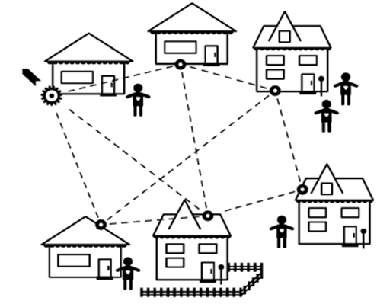
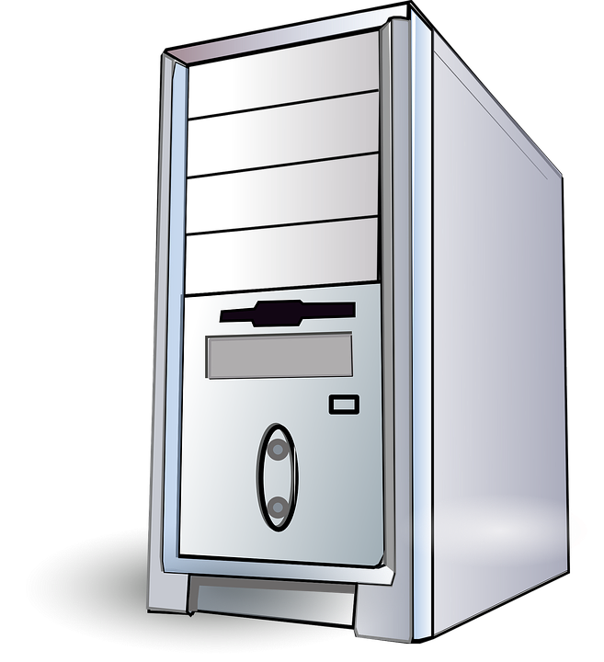
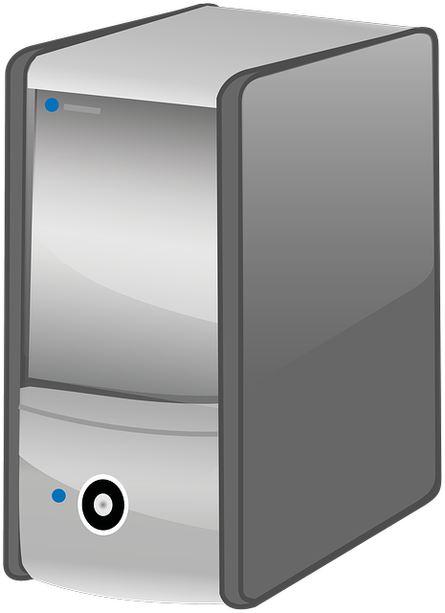
Back-end Platform Architecture
Master node (the equivalent of a miner node)
Runs the master node software of the blockchain platform
Has one or more high-end graphics cards
Maintains the distributed ledger of events for the units in the neighborhood
Provides image processing for the assigned validation nodes
Gets rewarded with the crypto-coin of the network for the proof-of-computing
Does not get rewarded for maintaining and replicating the distributed ledger
Sends alarm messages to law enforcement and to the crowd security participants
Validation node
Runs the validation node software of the blockchain platform
Maintains the distributed ledger of events for the units in the neighborhood
Possibly runs the AI models of only its own image processing
Does not get rewarded for maintaining and replicating the distributed ledger
Sends alarm messages to law enforcement and to the crowd security participants

